Slide 1
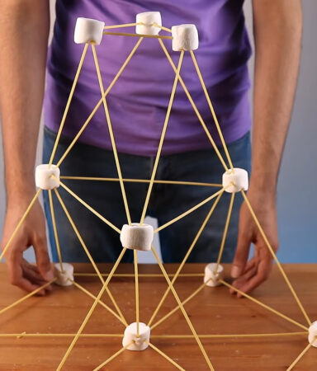
Ice Breaker Activity: Marshmallow Spaghetti Tower Game
Training and Development
Let's Build and Bond!

Slide 2

Welcome!
Hi everyone! Welcome to today's ice breaker activity.
We’re going to have some fun building marshmallow spaghetti towers.
This activity will help us get to know each other and encourage teamwork.

Slide 3
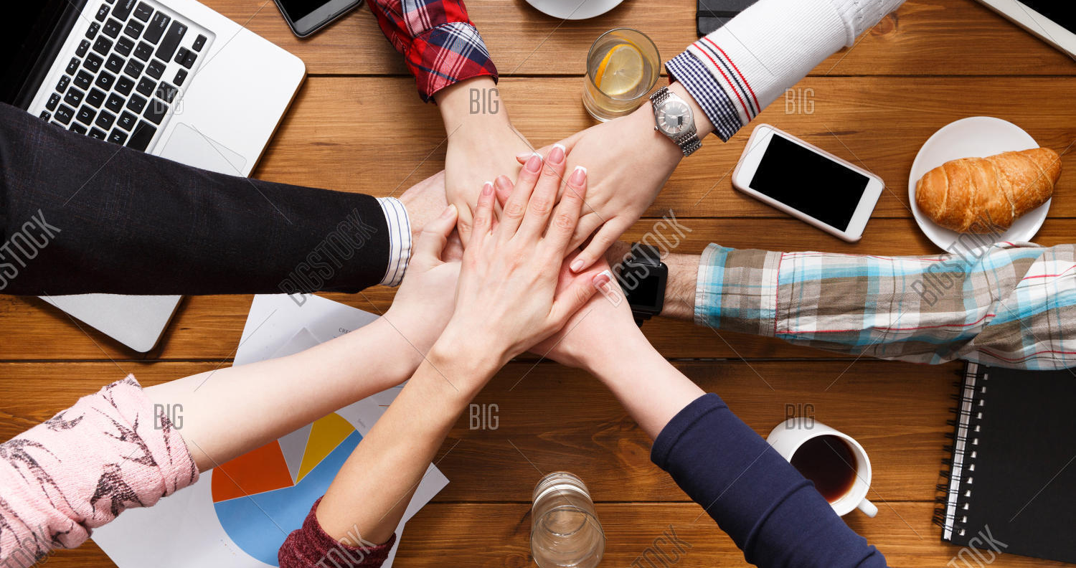
Meet the Team
Gurwinder Singh
Manpreet Kaur
Sukhminder Kaur
Rahul Gupta

Slide 4
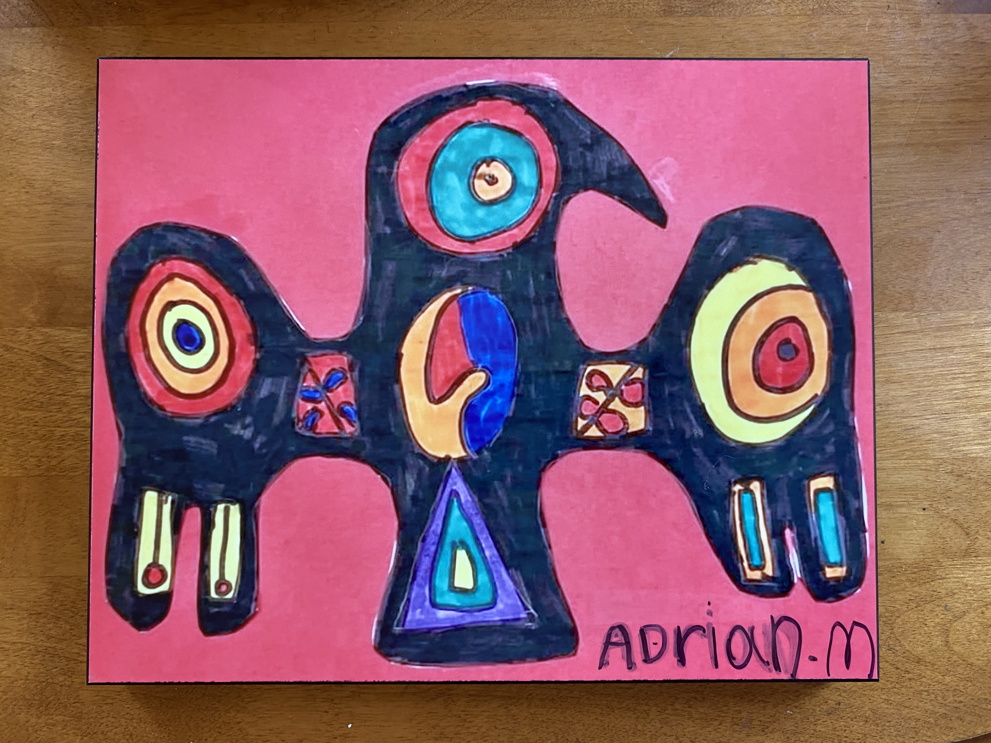
Georgian College's Land Acknowledgement
Please see my Land Acknowledgement that is a work in progress as I am learning to be an Indigenous Ally.
As a faculty of Georgian college, I acknowledge that all campuses are situated on the traditional land of the Anishnaabeg people. The Anishnaabeg include the Odawa, Ojibwe, and Pottawatomi nations, collectively known as the Three Fires Confederacy. We also acknowledge the Wendat Nation (Huron) who occupied these lands prior to the middle of the 17th century.
Georgian College is dedicated to honouring Indigenous history and culture and committed to moving forward in the spirit of reconciliation and respect with all First Nations, Metis, and Inuit people. As a member of this community, I commit to continuing to the following:
1.To “pay attention” and notice the land every day
2.learn and contribute to this reconciliation by educating myself,
3.listening,
4.sharing my knowledge with students and modeling appropriate behavior
5.Showing respect by humbly modeling the imperfection of learning and
6.being a devout caretaker of the land.
Credit. Adrian Murray 2022.

Slide 5
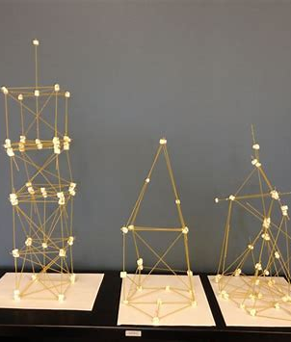
Objective of the Game
Build the tallest free-standing structure using spaghetti, tape, string, and one marshmallow.
The marshmallow must be on top.
This activity promotes teamwork, creativity, and fun!

Slide 6
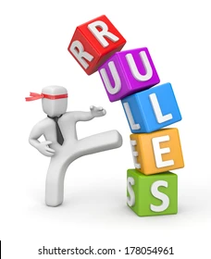
Rules
You have 10 minutes to build the tallest tower.
The tower must stand on its own.
The marshmallow must be on top.
Use only the provided materials.

Slide 7
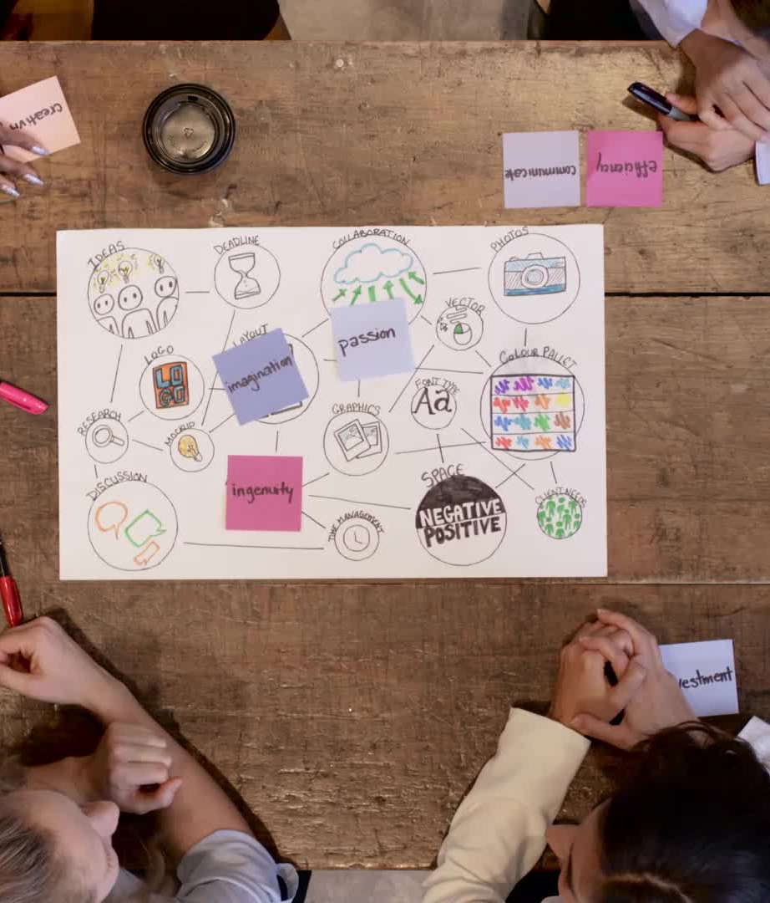
Tips for Success
Plan: Discuss your ideas before you start building.
Collaborate: Work together as a team and use everyone's skills.
Test: Test your structure's stability as you go.
Be Creative: Think outside the box and be innovative.

Slide 8
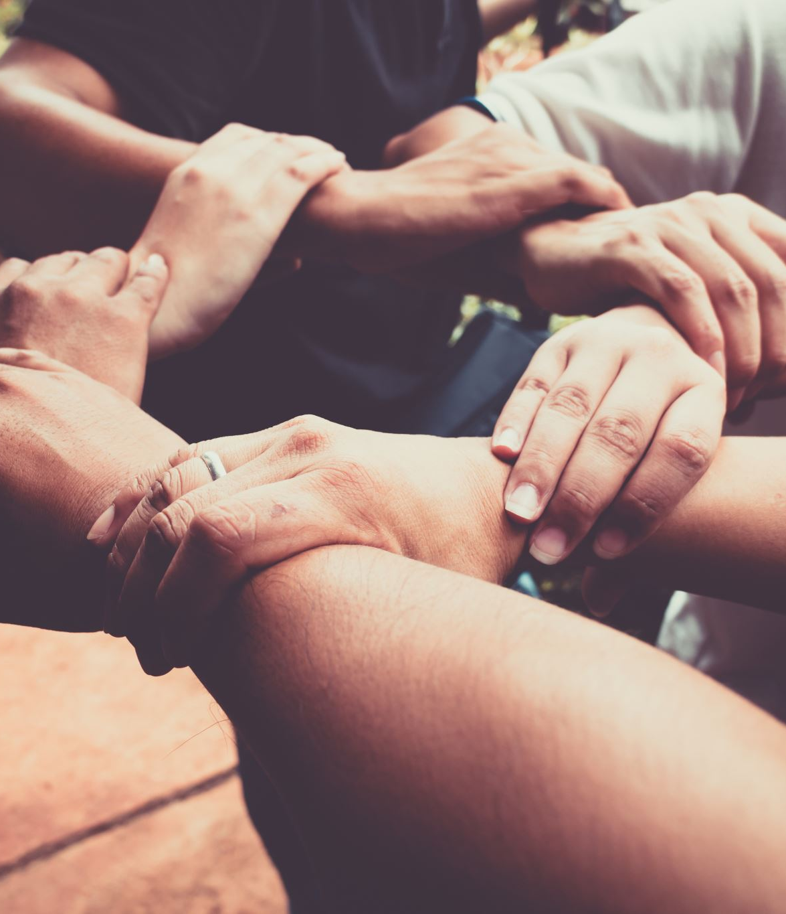
Time to Build!
Split into teams of 3-5 people.
Start the timer. You have 10 minutes!
Countdown

Slide 9

Time's Up!
Stop building and step away from your structures
Let's measure the height of each tower.
Announce the winning team with the tallest tower.

Slide 10
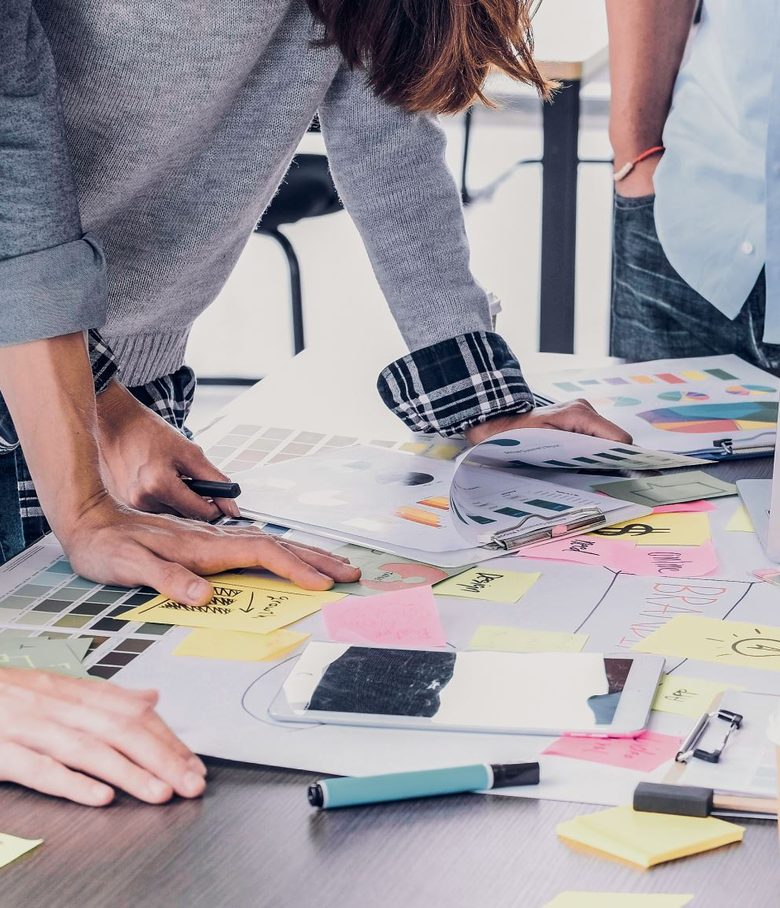
Learning Outcomes
Teamwork: Understanding the importance of collaboration and leveraging each team member's strengths.
Communication: Enhancing communication skills to effectively share ideas and solve problems.
Creativity: Encouraging innovative thinking and creative problem-solving.
Resilience: Building resilience by learning from challenges and setbacks.
Time Management: Developing skills to manage time effectively and work efficiently under pressure.
Fun and Engagement: Fostering a sense of enjoyment and engagement in group activities.

Slide 11
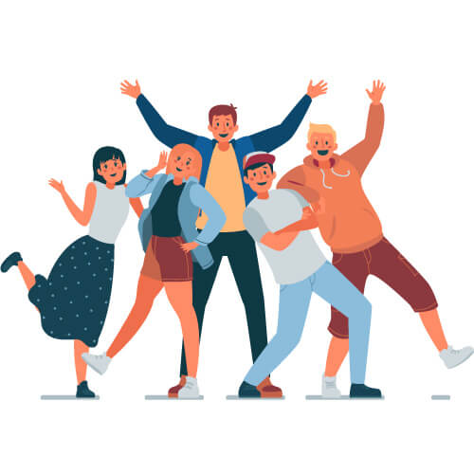
Thank You for Participating!
We appreciate your enthusiasm and teamwork.
Remember the skills and lessons learned today.
Looking forward to more fun and productive activities together!

